Slide 1
Ridesharing with Social Network
李照

Slide 2
Problem Definition
Three types of instance: customer, vehicle, and social network.
One road network.
A series of requests from customer.
A schedule (route) for each vehicle.

Slide 3
Customer
Customer id: the identity number of customer.
Origin id: id of the origin node.
Destination id: id of the destination node.
Early time: early bound for time window.
Late time: late bound for time window.
Load: capacity cost of customer.
Status: waiting, on_board, arrived, cancelled.
Assign to: associated vehicle id.

Slide 4
Vehicle
Vehicle id: identity of vehicle.
Origin id / Destination id / Early time / Late time.
Load: matched customers but not picked yet.
Distance: distance to next node.
Route: array of every nodes that vehicle passes by.
Schedule: array of destination nodes.
Route id: current node id of vehicle.
Vehicle status: waiting, in_route, arrived.

Slide 5
Social Network
Network id: identity of social network.
Customer id: identity of customer.

Slide 6
Other parameters
Road network:
Node1: id of from node.
Node2: id of to node.
Distance: distance between node1 and node2 (in meter).
Longitude: position.
Latitude: position.
Request:
Post time: order post time.
Waiting time: customer would wait until cancel the order.
Late tolerance: customer would accept arrives later than late time.

Slide 7
Experiment Set
Use Cargo [VLDB 2019] as base simulator.
Modified to fit social network (under MIT license).
About 400 line of codes added.
Social network constraint: only customers in same social network can in same vehicle.

Slide 8
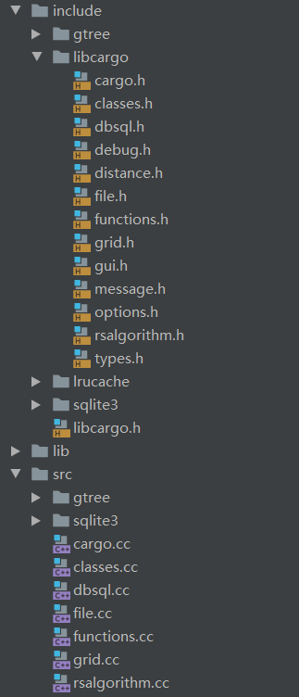
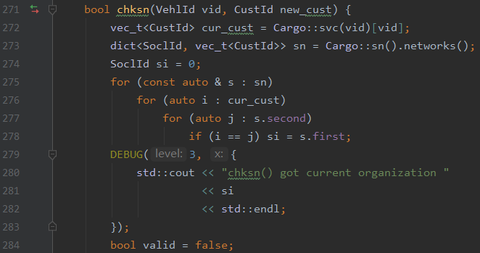
Experiment Process
Build Gtree from road network.
Read dataset into memory.
Based on time, count to process operation.
Generate report of result.

Slide 9
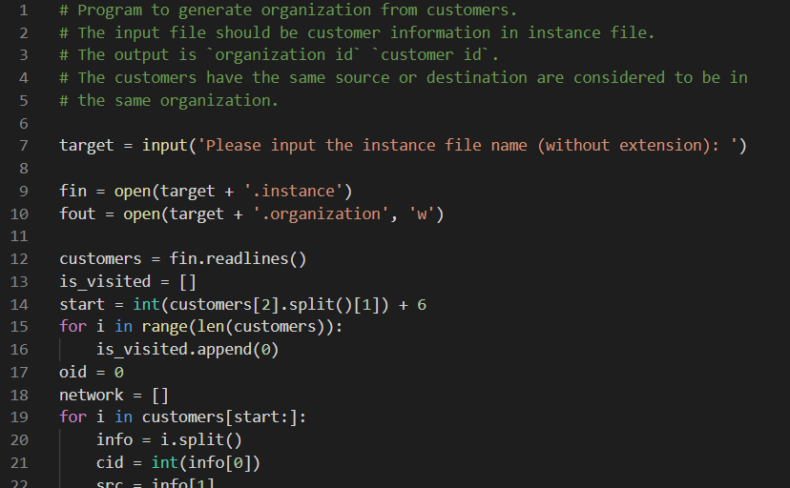
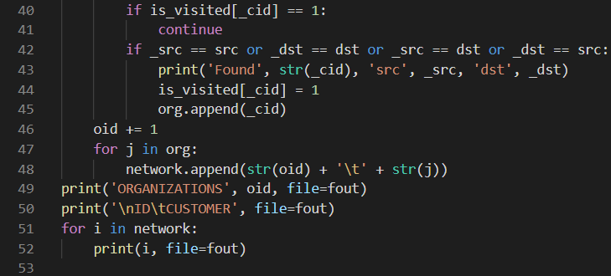
Generate Social Network
Assumption: customers with same origin node or destination node would be in same social network.
For example: colleagues in same building, classmates in same campus, neighbors in same department…

Slide 10
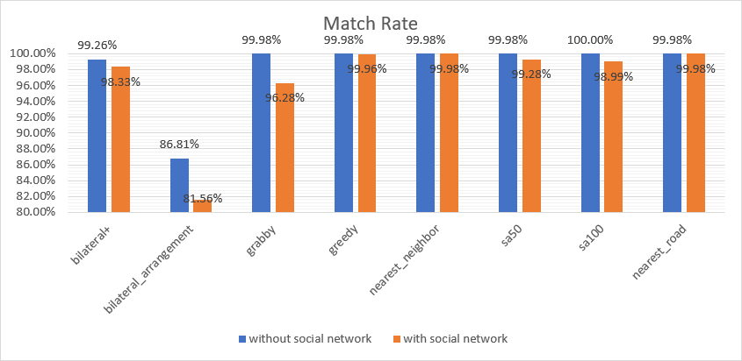
Experiment Result
Under Manhattan’s taxi data, different algorithms performs.

Slide 11
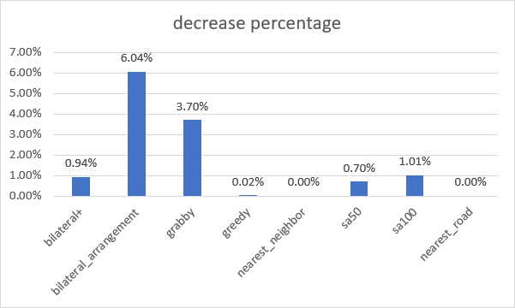
Comparison of Social Network
The match rate would lower after constrained by social network.

Slide 12
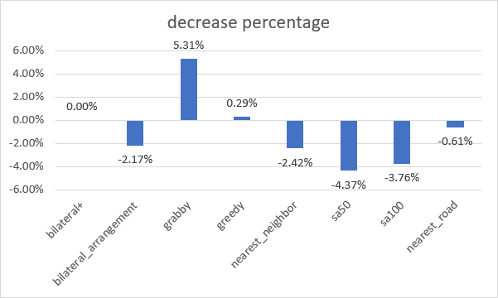
Comparison of Social Network
If social network are large and with small amount, the constraint may optimize the performance.

Slide 13
Future Work
Use event-based simulator to replace time-based simulator.
Design algorithm for social network.
Gather information about social network and Ridesharing.
(Optional *) Change the problem definition to make better model.

